Slide 1

Graduation presentation…
What is it about?

Slide 2
According to the prediction of my statistical model, some of you have already heard about the topic:

Slide 3
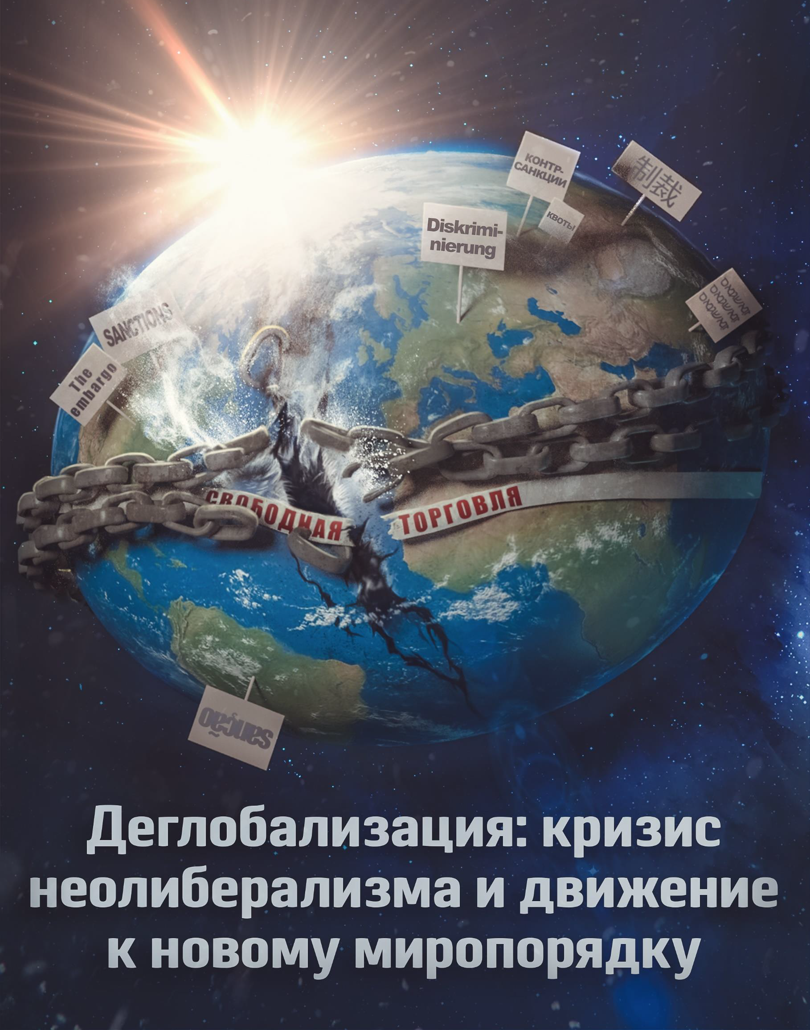
So, I’m going to present a research about deglobalization from the point of view of PolitEconomics.

Slide 4

Warning note
I don’t have enough time to present all the work in details
Something will be added from myself
It would be interesting to consider some critical response to the report but I also don’t have enough time for it. (Those responses claim that the work is too schematic and simplified)

Slide 5
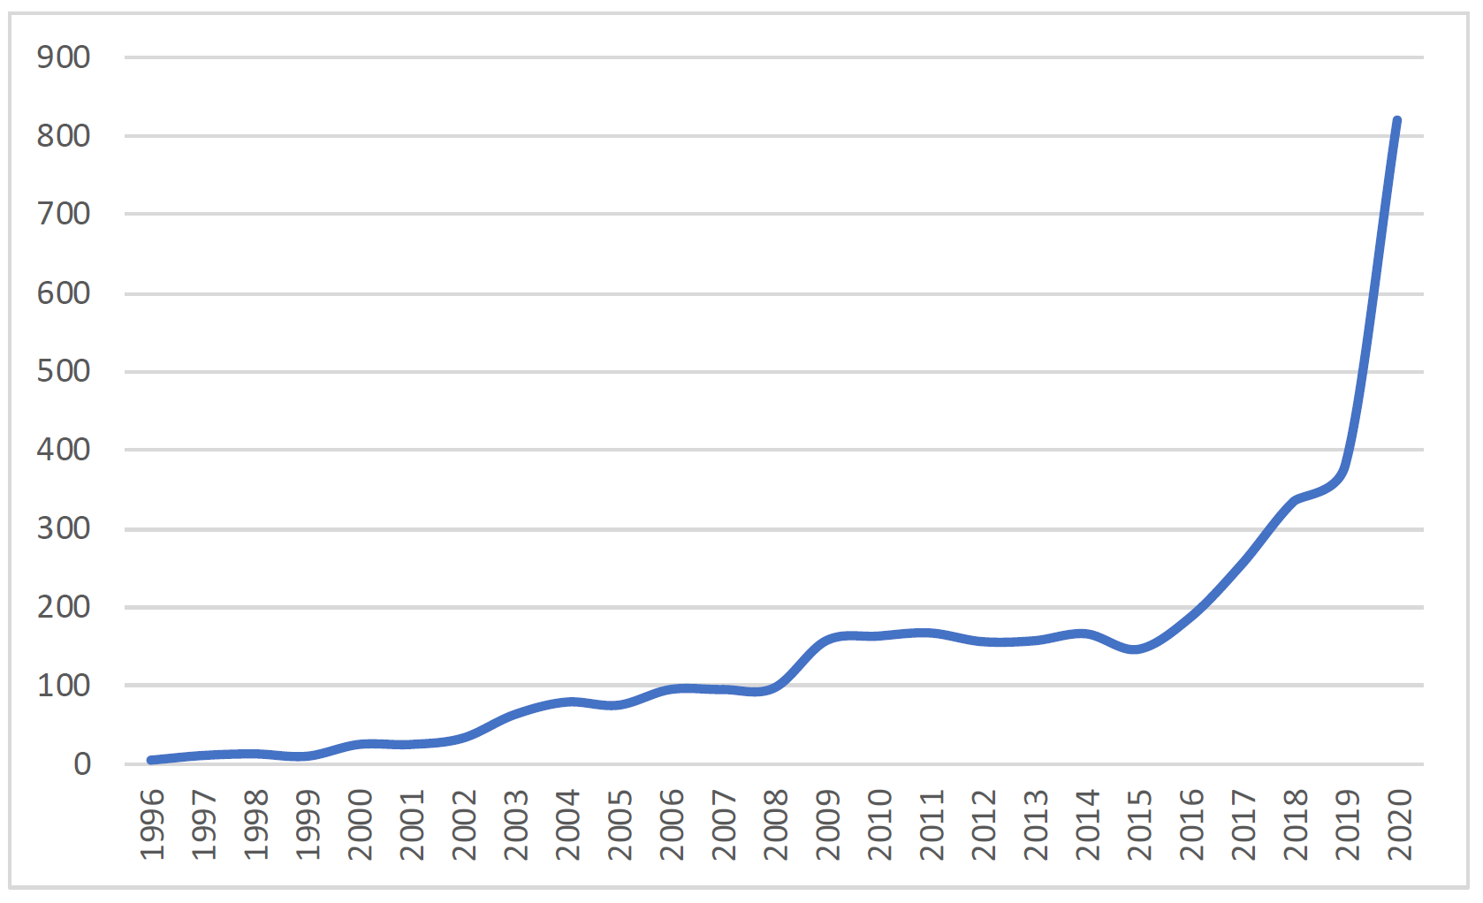
Scientific works about Deglobalization

Slide 6
To understand, what globalization is, let’s try to analyze, what is the force that moves capital and leads to integration or de-integration.

Slide 7
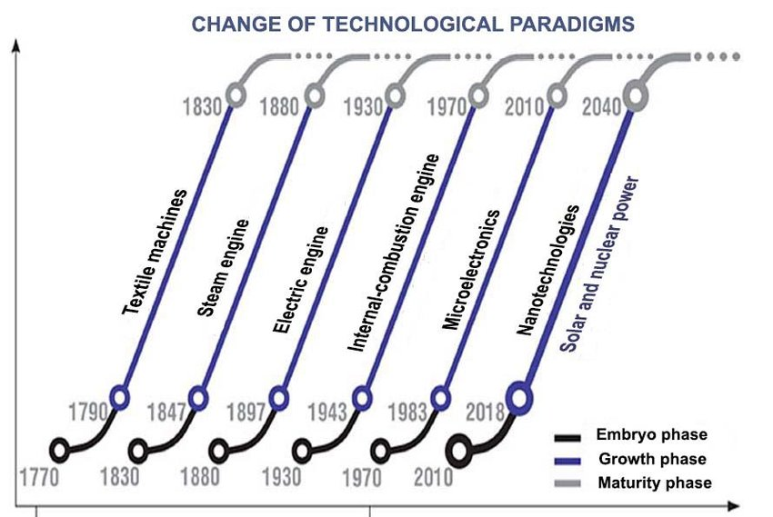
Technological paradigms

Slide 8
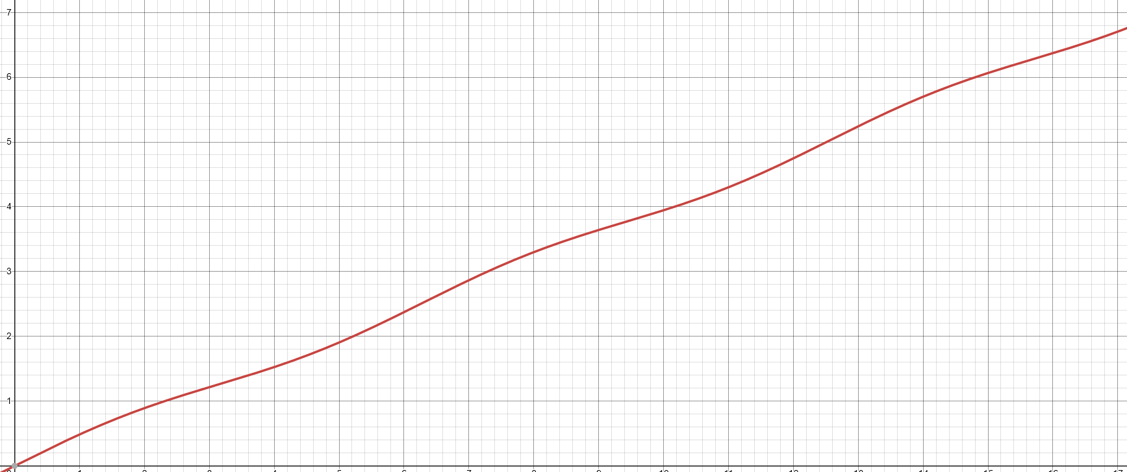
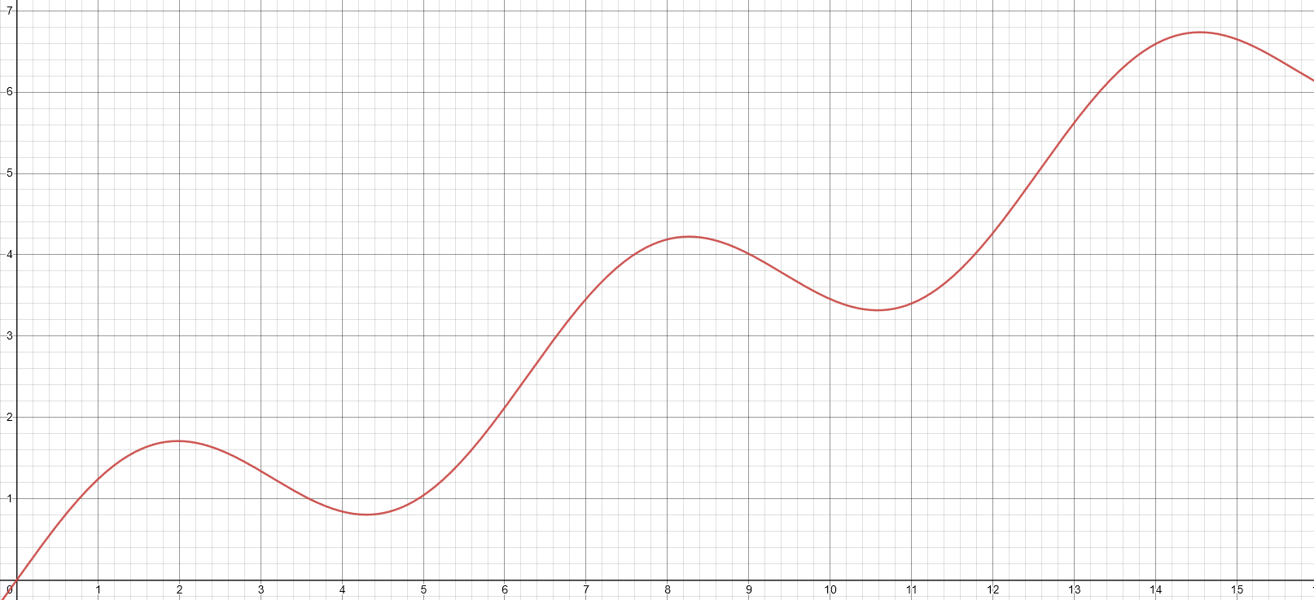
The idea is that the progress of fundamental science which allows to implement technologies of a particular technological paradigm is by far not directly connected to those cycles and is almost homogenous.
Informal demonstration of progress in:
Science:
Economics:

Slide 9
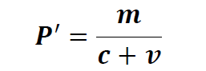
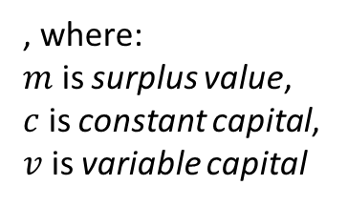
Rate of return shows the profitability for investors: this is the «driver» which shows where to invest and basically determines their behavior.
, where:
$m$ is surplus value,
$c$ is constant capital, $v$ is variable capital

Slide 10
That’s why it makes sense to speak about global index «Rate of Return» in an economy of a country.

Slide 11
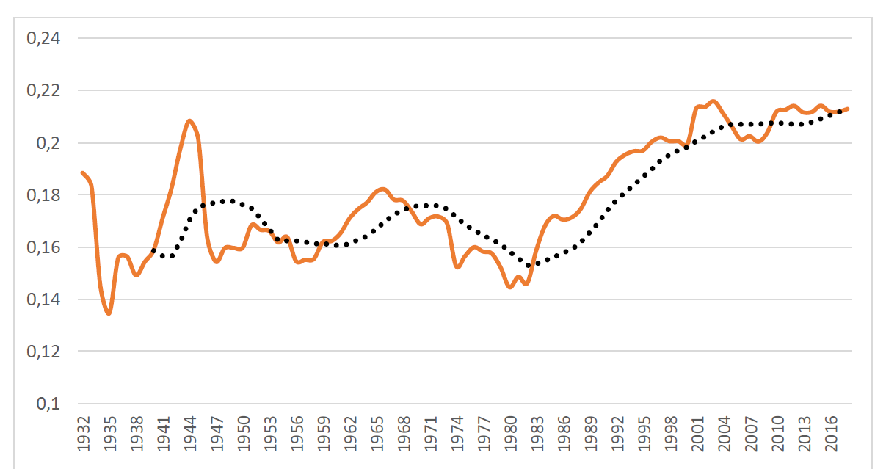
The dynamic of this index in the USA economy:
Obviously, low RoR in the end of 70s and the absence of competitors of the USA pushed its capital from the country — to look for cheap labor in the periphery.

Slide 12
It can be noticed that there are some long term (≈50-year) trends that are correlated with technological paradigms’ alteration. But why are the things this way?

Slide 13
There are also other valuable processes connected to technological paradigm alteration
Constant capital is higher in the stage of wide spread of the paradigm
Unemployment is higher the stage of its collapse
And Financial_share, which is the fraction of financial markets in GDP is too
(Unfortunately, I don’t have time to explain this processes…)

Slide 14
To prove this considerations a logistic regression model had been developed.
The model predicts a binary variable «stage», where «1» is responsible for the wide spreading stage.

Slide 15
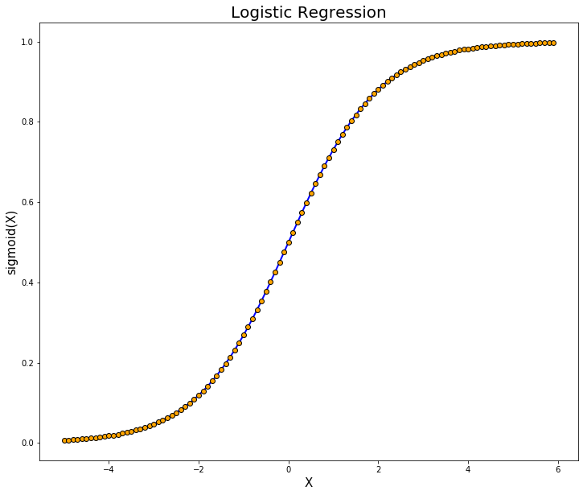
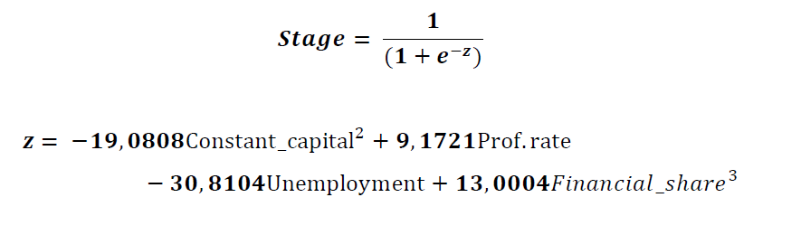
(Monotonically increasing function)
It can be clearly seen that the stage correlates
Positively with:
Profit rate
Financial share
And negatively with:
Constant capital
Unemployment

Slide 16
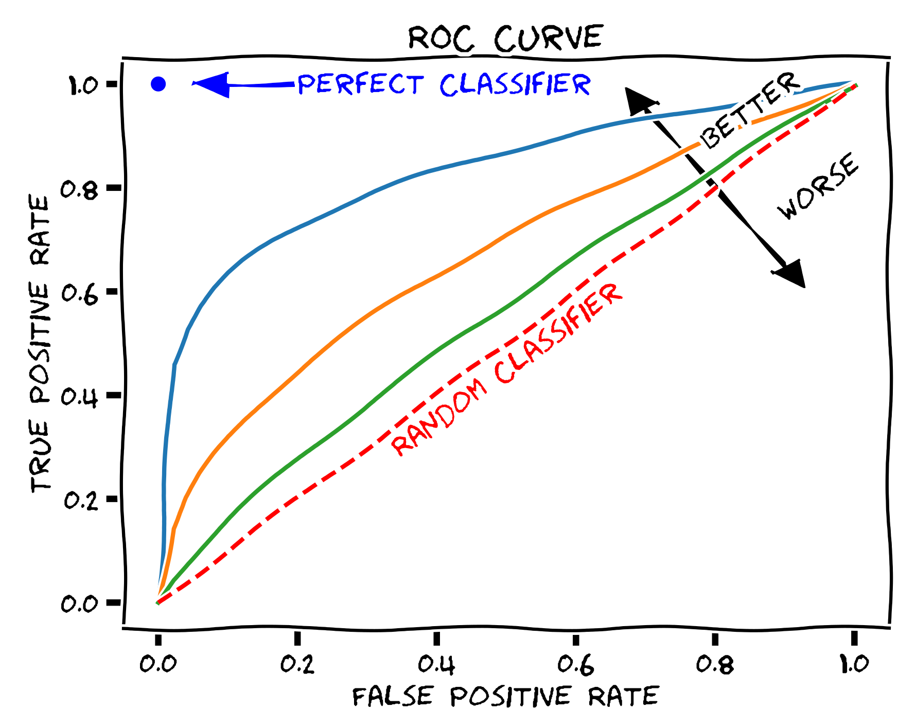
ROC_AUC value for this model is ≈ 0.934, therefore we can conclude that the correlation is statistically significant.

Slide 17
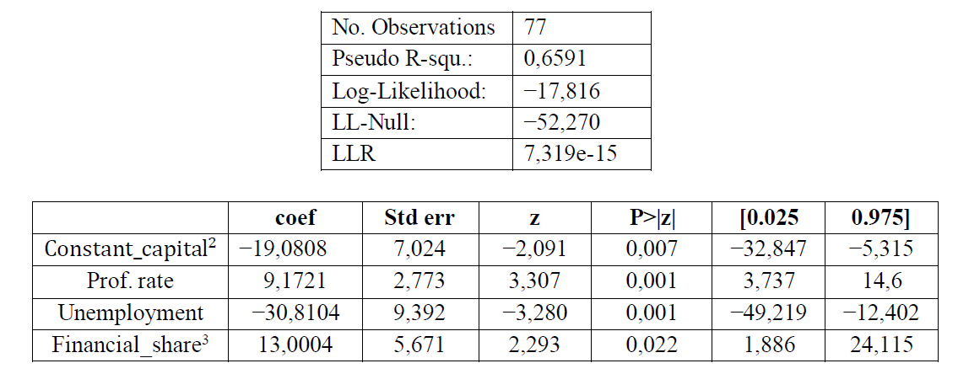
…and p-values for all the parameters are lower than 5% which witnesses that all of them make sense.

Slide 18
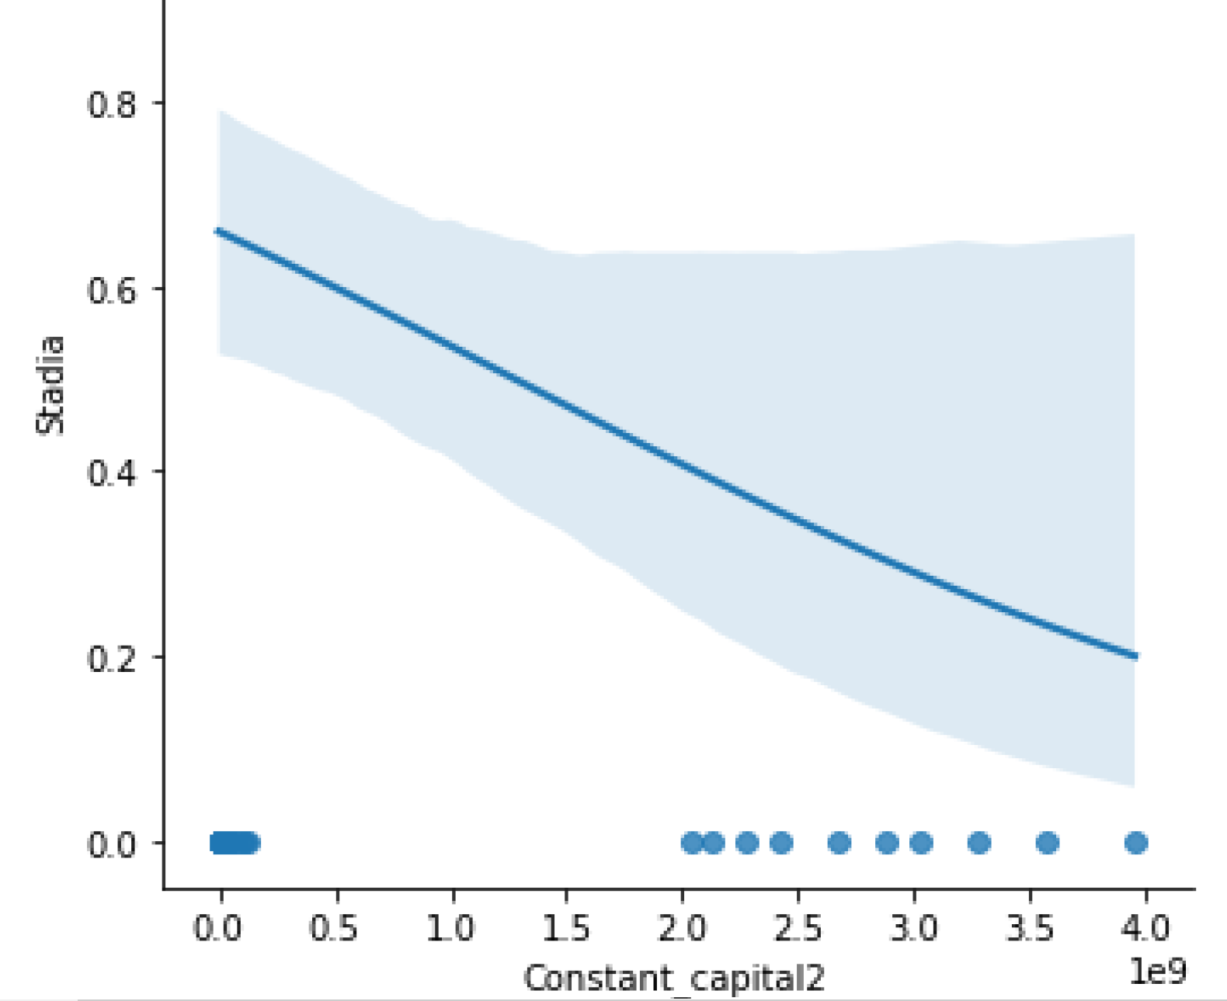
Constant Capital

Slide 19
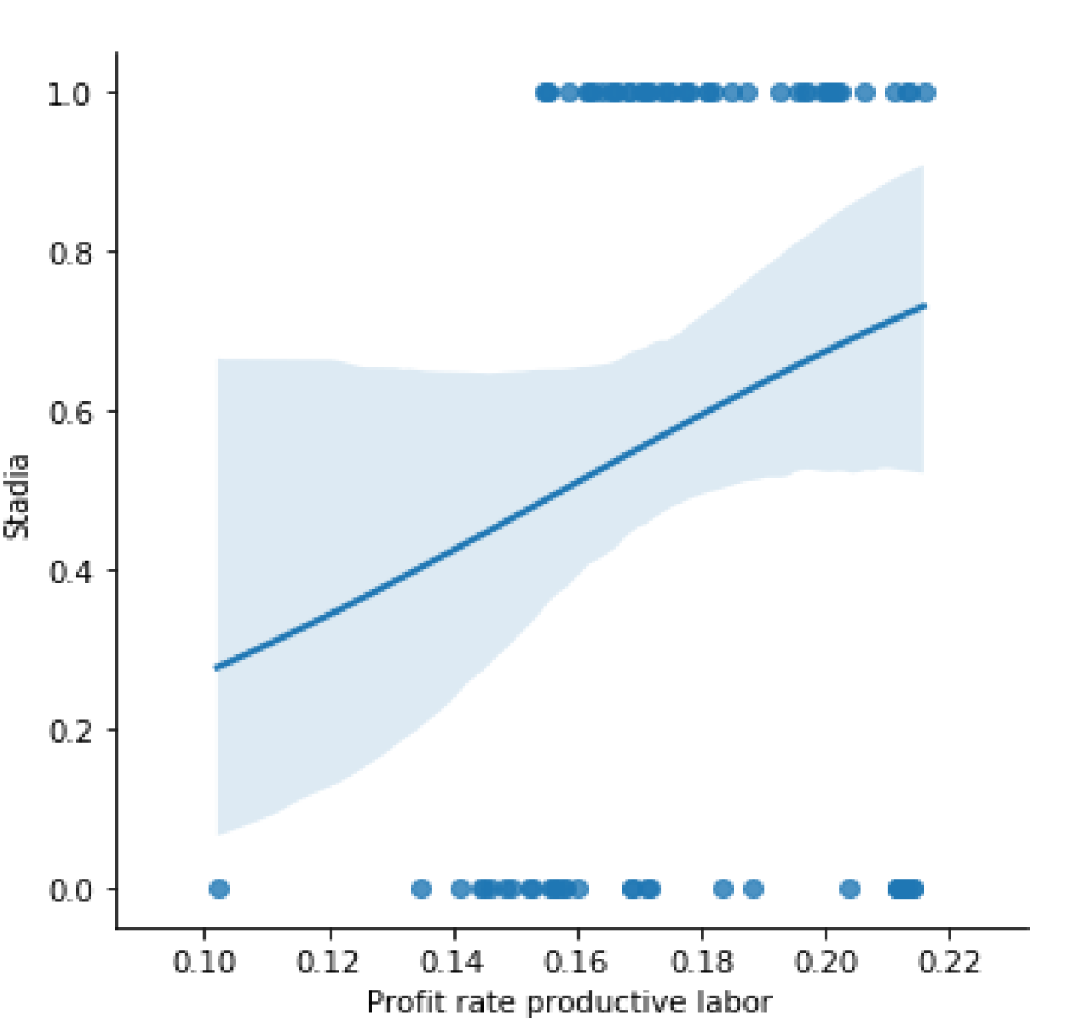
Profit rate/Rate of return

Slide 20
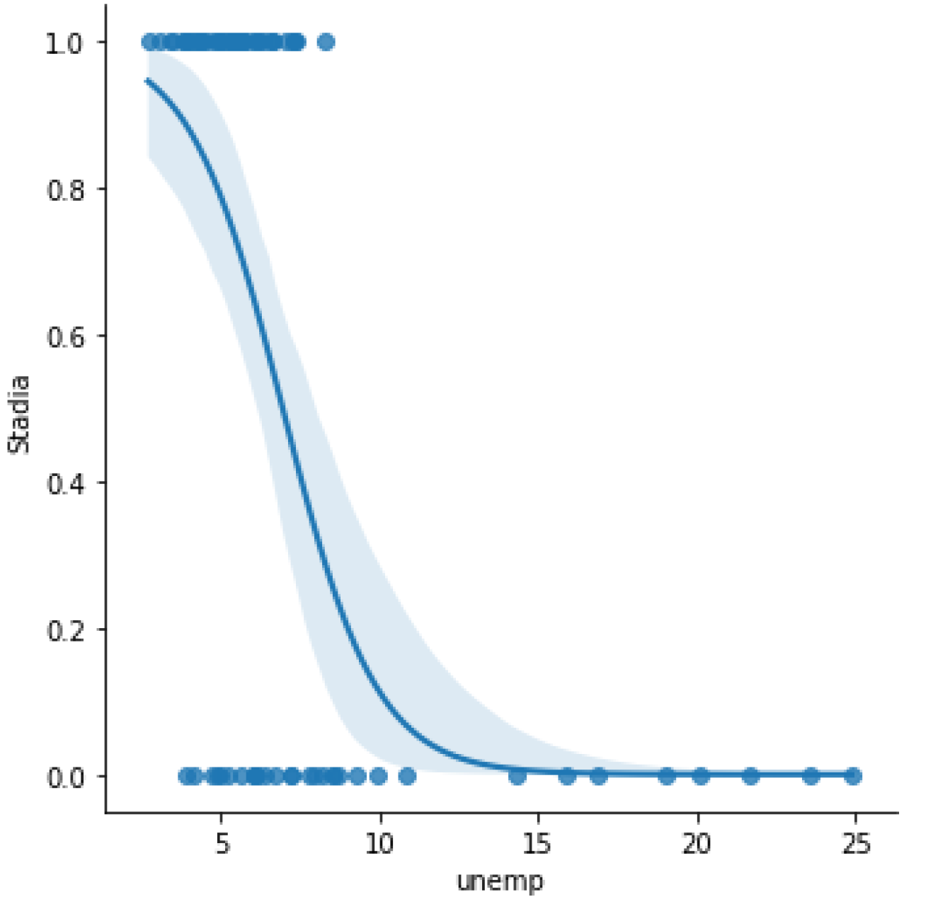
Unemployment

Slide 21
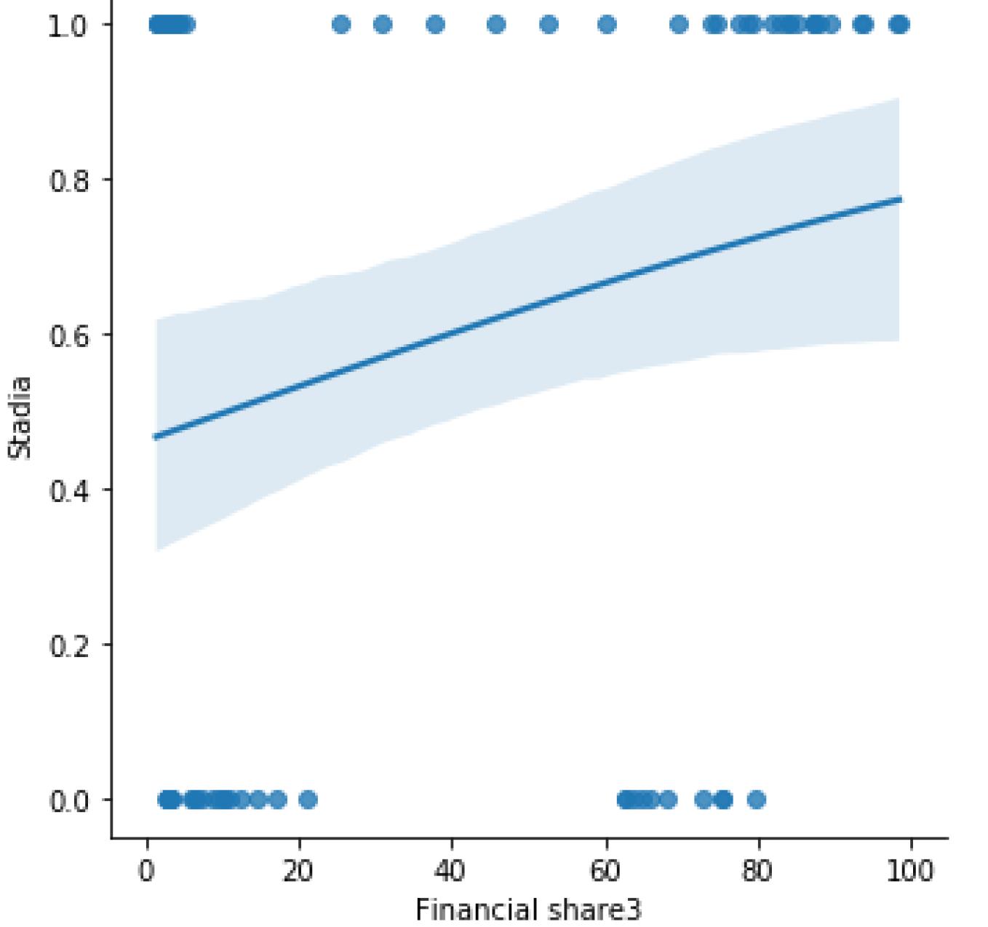
Financial share

Slide 22
So, it becomes obvious that striving for innovations isn’t an immanent property of capitalists: new technologies are only introduced when there other sources of profit expires (which is a synonym to «when the Rate of Return index is low»).

Slide 23
It’s also notable that:
At the phase of integration of the next technology leading countries mostly have protectionist policy: they are fencing domestic manufacturers.
But the phase of wide spread they force other countries to open markets to sell the goods.

Slide 24
The contradictions of the «Neoliberal» Globalization (1980s-2010s)

Slide 25
What’s the Neoliberal Doctrine?
Rejection of the Keynesian policy of demand management by the government
Deregulation of major industries
Deregulation of the financial sector
Weakening of environmental supervision and labor protection
Restriction of antitrust policy
Privatization of state property
Cancellation or reduction of social security programs
Reduction of taxes on business and rich households
(Basically, it’s the domination of capital over labor and being open for foreign capital)
Rich countries enforce poor ones to follow this doctrine.

Slide 26
In the course of globalization we can see the transfer of low-profit production from developed countries to some of the others. This is the way the economic "miracles" of Taiwan, China and so on were achieved. Now China itself delegates primitive production to other countries which are even lower in the world-system hierarchy.

Slide 27
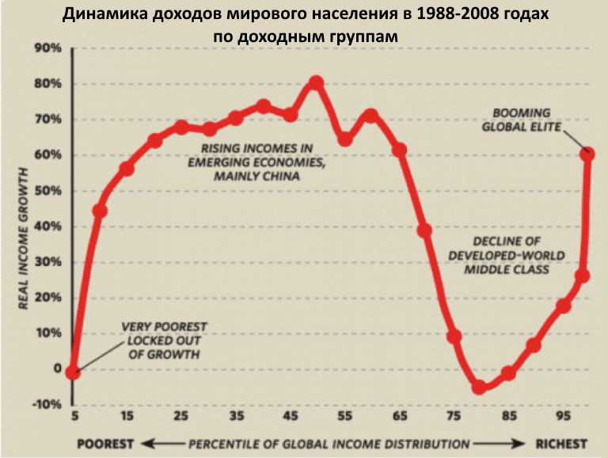
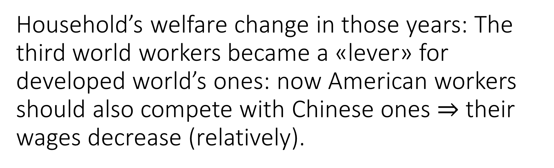
Household’s welfare change in those years: The third world workers became a «lever» for developed world’s ones: now American workers should also compete with Chinese ones $⇒$ their wages decrease (relatively).

Slide 28
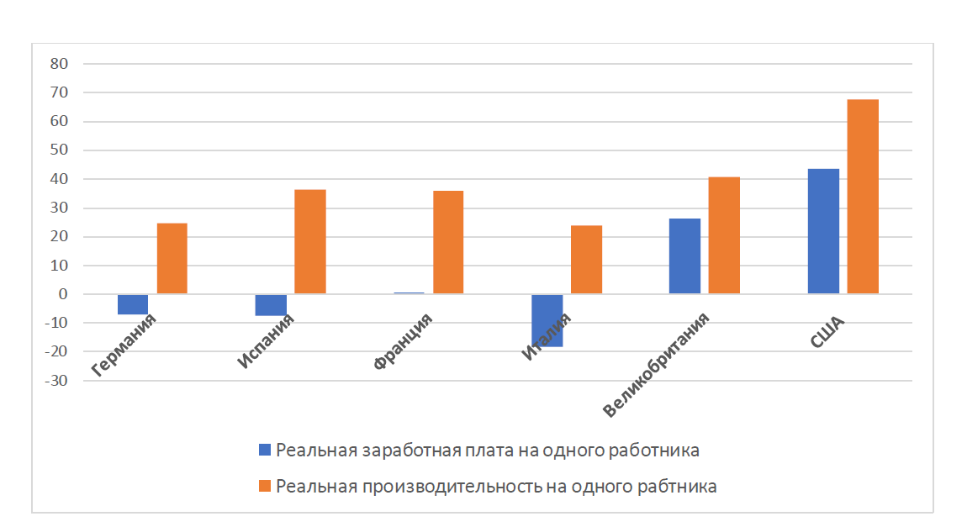
So, while labor productivity increases in developed countries, real financial benefits don’t change so fast or even decrease.

Slide 29

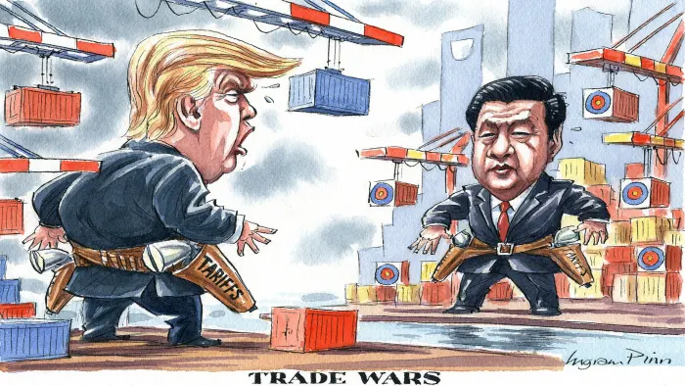
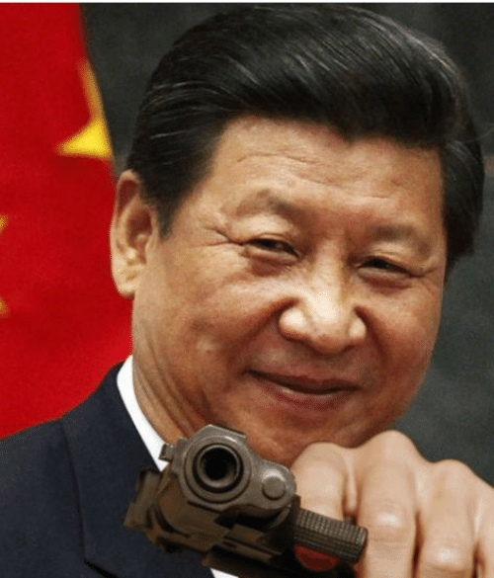

Trade war: who’s going to win?

Slide 30
Obviously, the trade war is a direct consequence of the rise of China, it’s expansion in third world countries (and US influence displacement) and America’s non-acceptance of that processes. Nowadays the technologies of 6th paradigm are being implemented in non-peripheral countries all around the world. It’s also one of the reasons for the trade war.

Slide 31
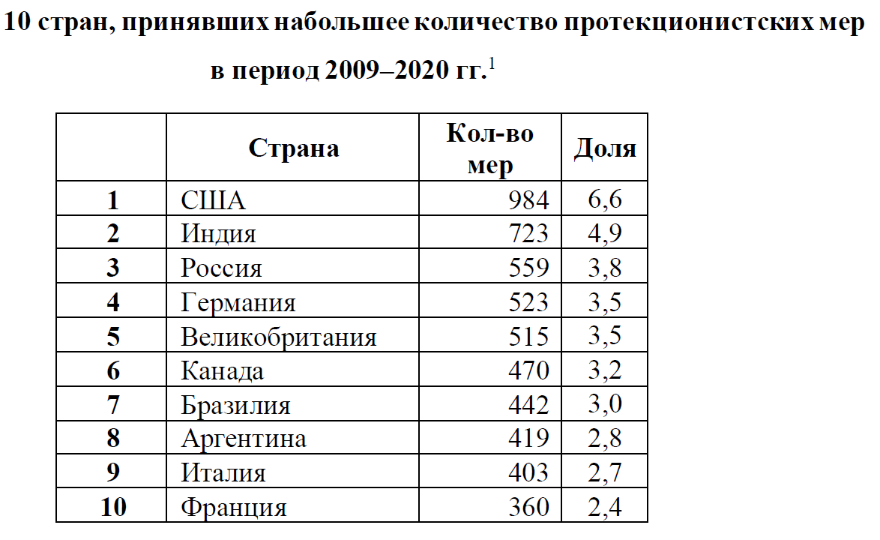
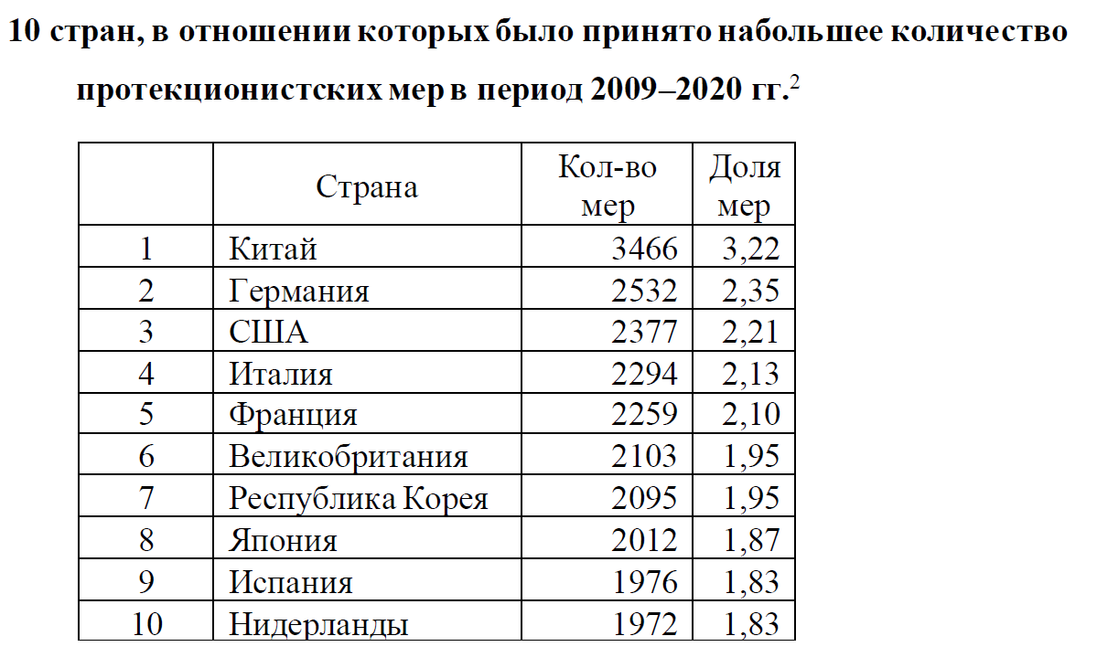
At the moment the country that supports globalization is China but not the USA

Slide 32
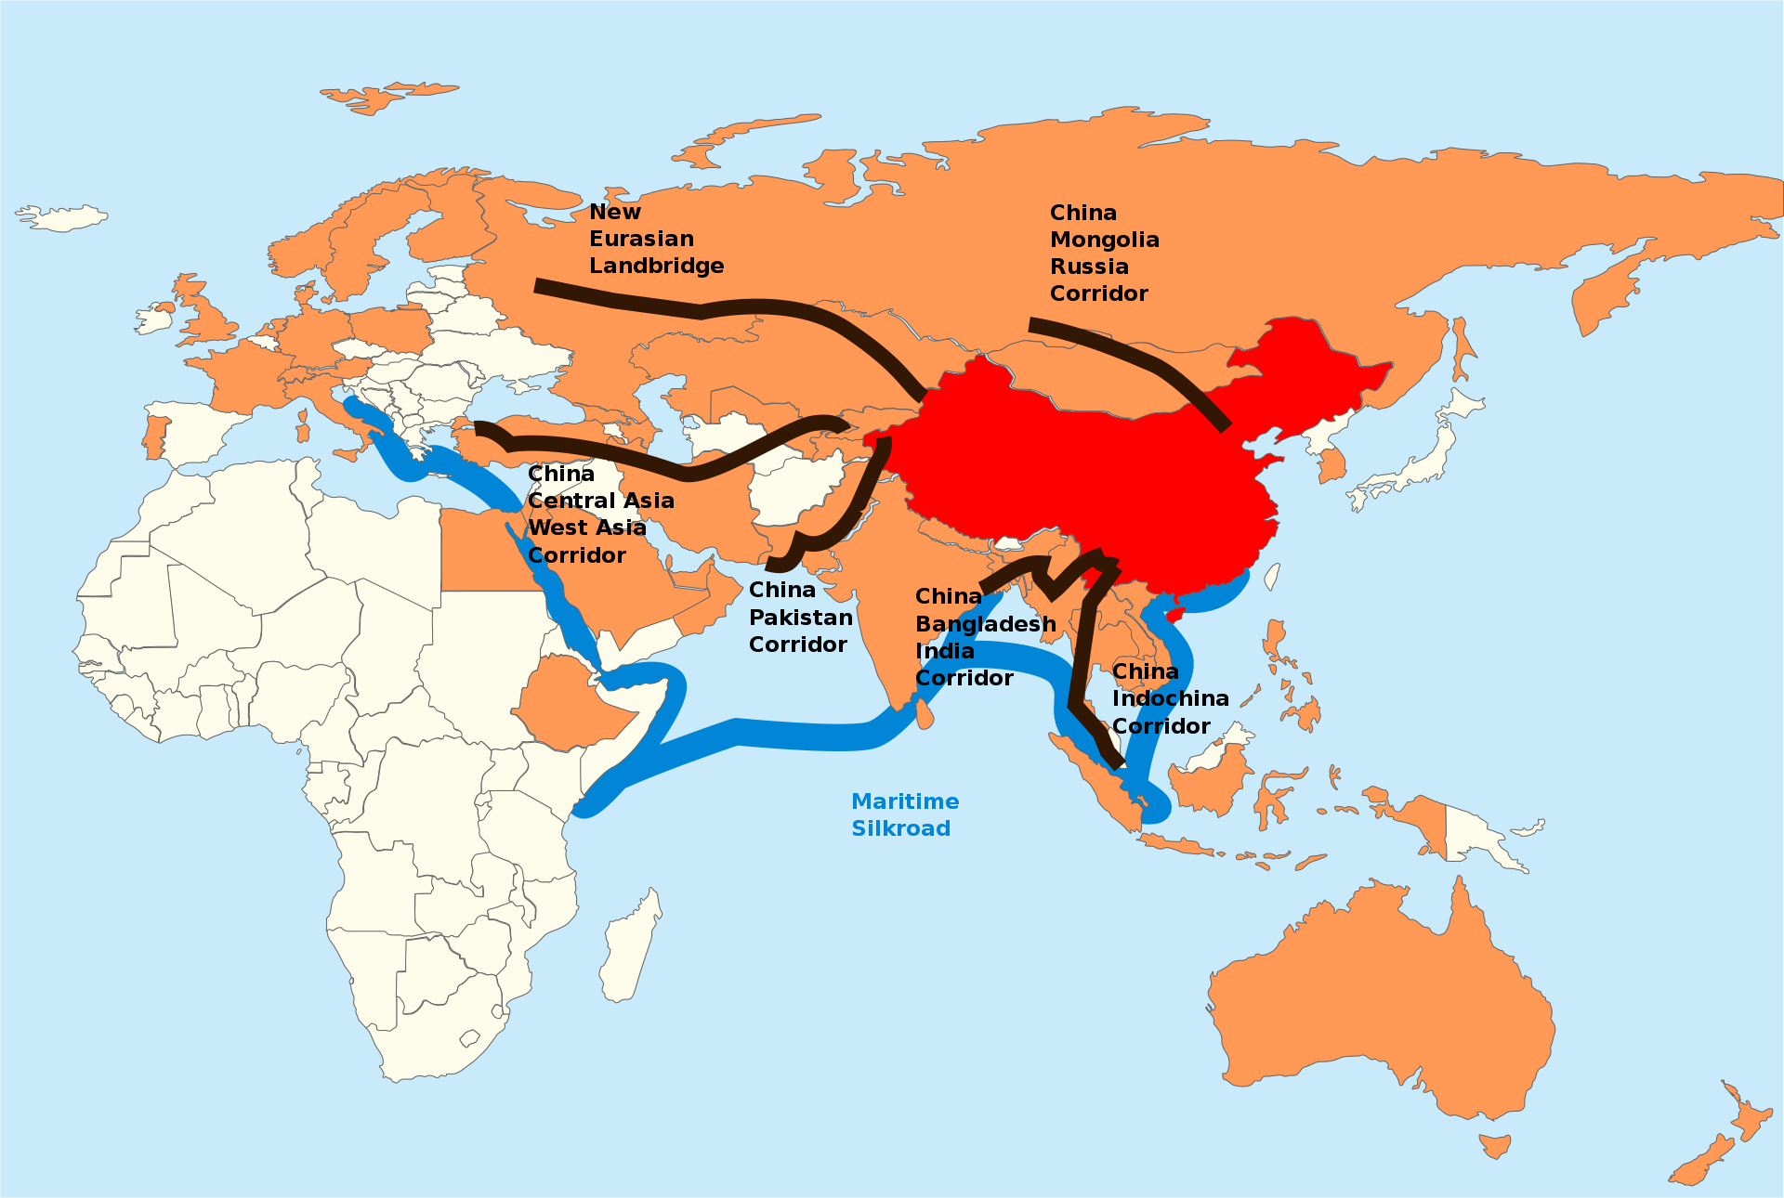
China’s strategy «One belt, One Road» of expansion.

Slide 33
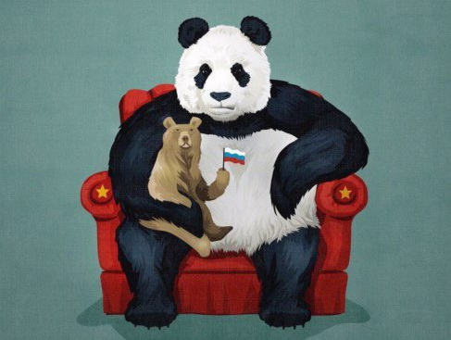
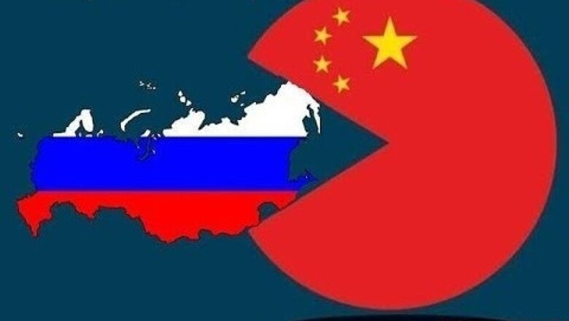
We can see that our country (Russia), especially — Siberia is one of the directions of China’s expansion: the roads are obviously being built to export wood, oil and other raw materials from Russia.

Slide 34
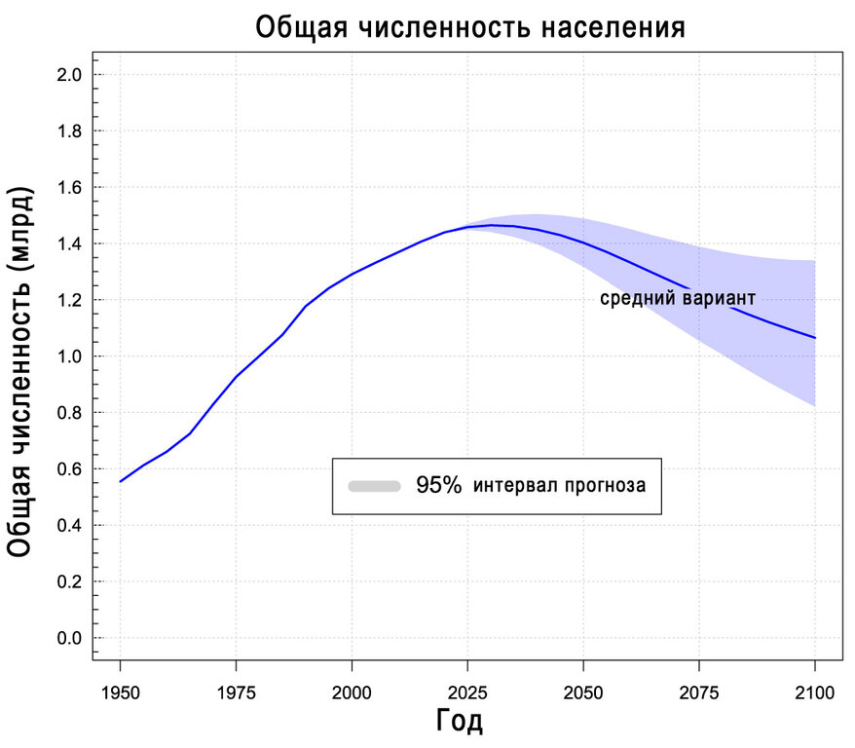
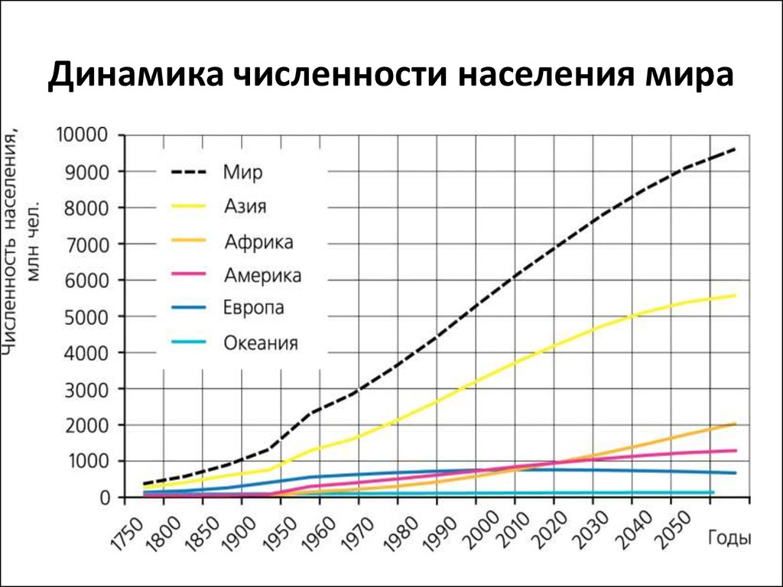
Does China want to annex Siberia? Is it true that Chinese people are already living there?

Slide 35
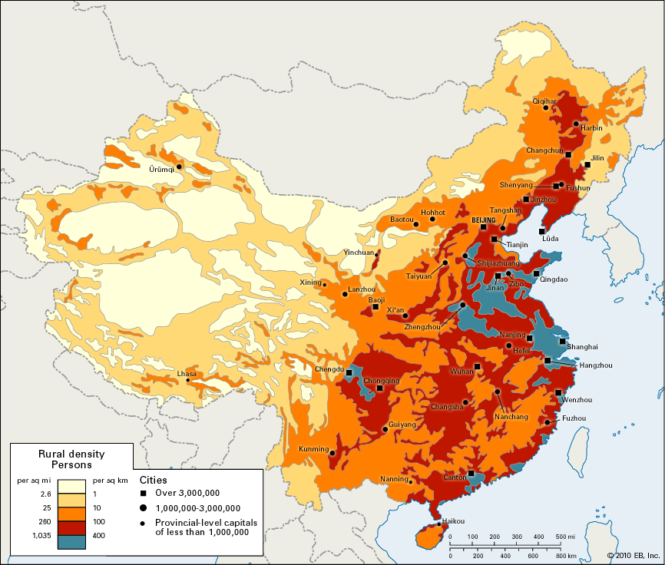
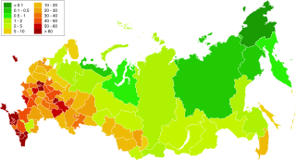
People Distribution in China and Russia:

Slide 36
China is already exporting the products it wants from this region and its bourgeoisie is totally satisfied with it. Siberia annexation would only cause problems for China. This is typical neo-colonialism.

Slide 37
Another example of one-belt-one-road strategy work case is that the direct way to the EU is China’s instrument of east European companies distraction: the low-surplus value production is transferred to the Eastern Europe (from the Western one) but the production is significantly more expensive than China ones and they don’t stand up to the competition. One of the examples is massive bankruptcy of metal producing companies in Europe.

Slide 38
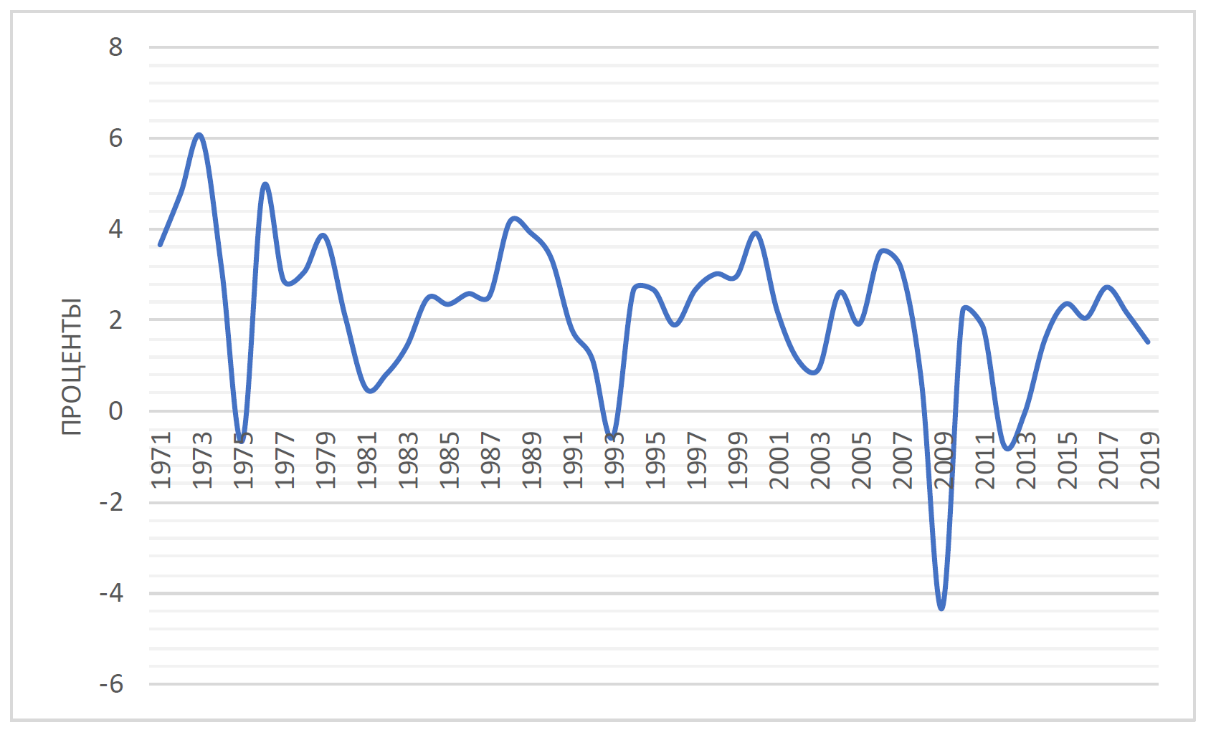
The EU has the internal contradictions mentioned. They lead to the political crisis of integration, even an economic one (diminishing speed of economical growth).

Slide 39
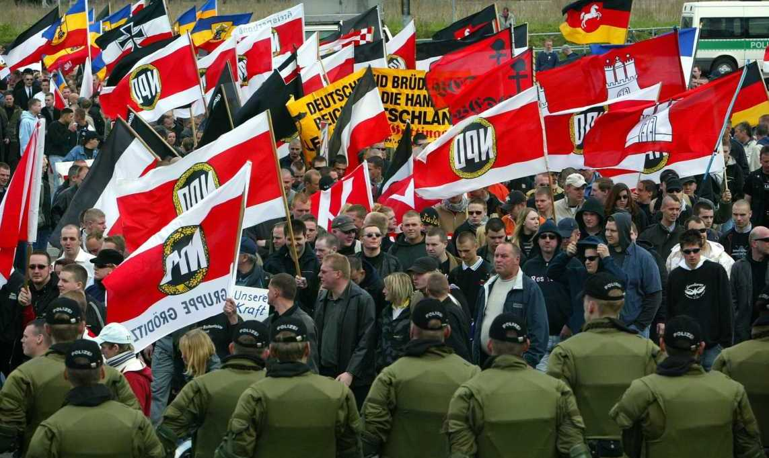
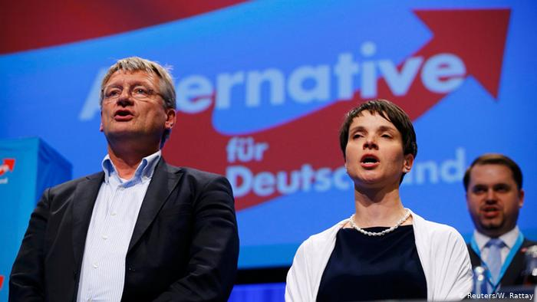
It also leads to the growth of «nationally-oriented parties» in popularity.

Slide 40
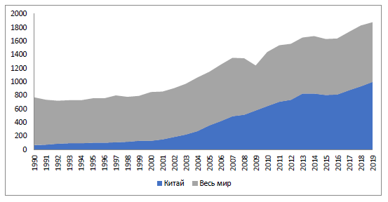
China’s and world’s steel production:

Slide 41
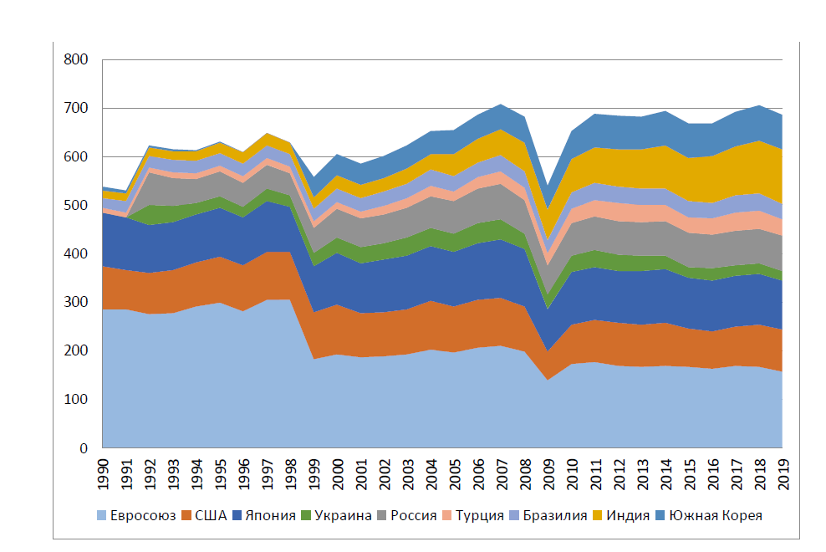
At the moment the confrontation in connection with steel production is pretty hot nowadays: USA, EU, China and etc. are introducing sanction against each other.
(The same graph excluding China)

Slide 42
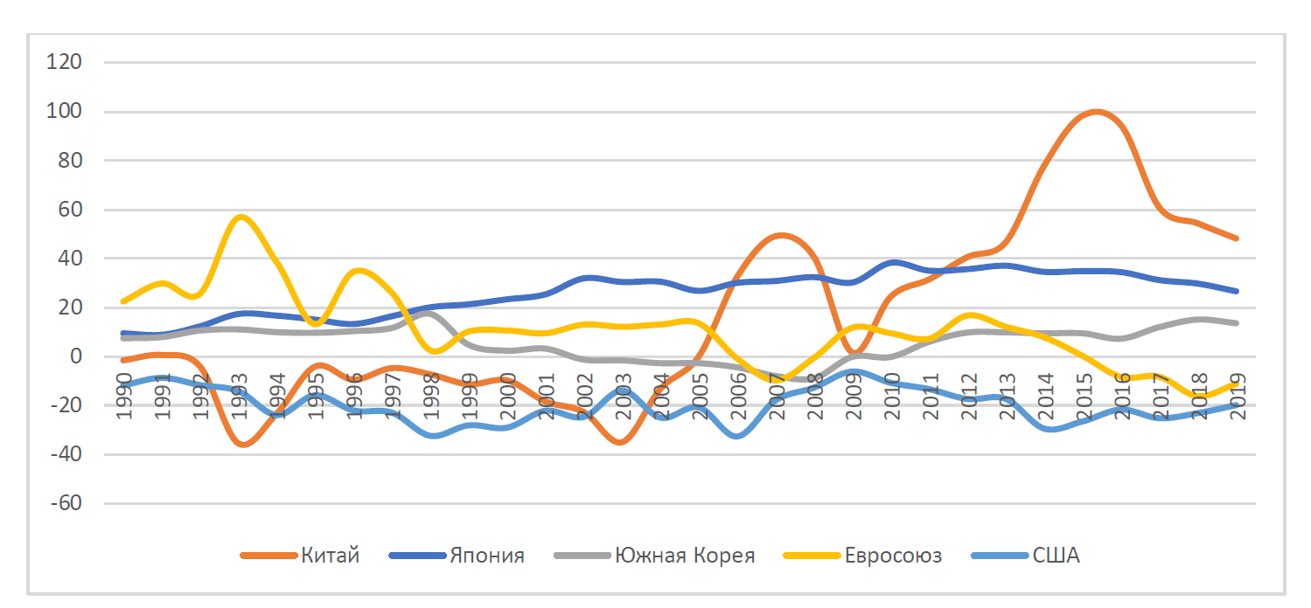
Due to sanctions, China didn’t decrease steel production: it is re-orienting it to inner market.
(Export-Import steel balance)

Slide 43

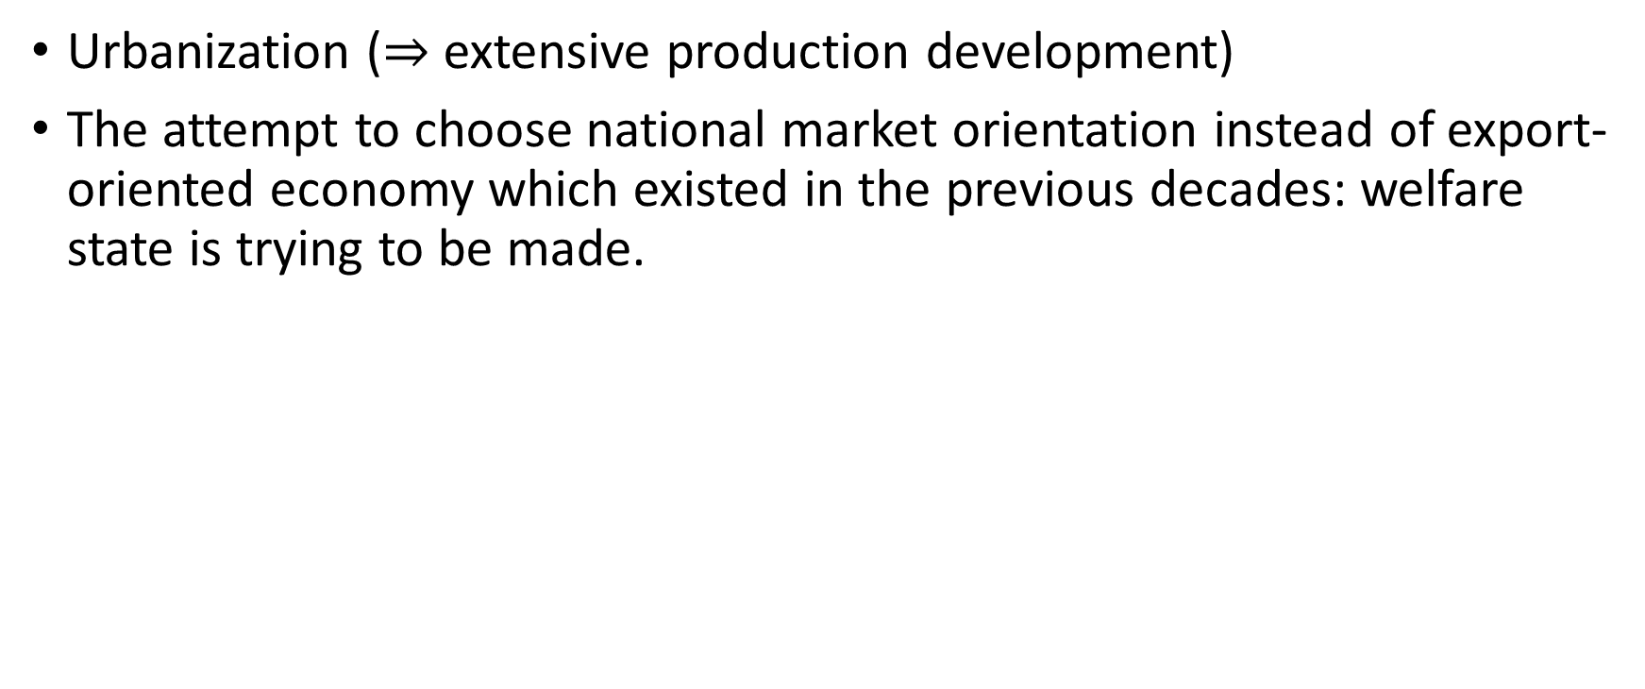
Main tendencies in China:
Urbanization ($⇒$ extensive production development)
The attempt to choose national market orientation instead of export-oriented economy which existed in the previous decades: welfare state is trying to be made.

Slide 44
It’s important to understand that it’s incorrect to say that China’s government is ideologically monolete. Actually, CPC is one of the most contradictory structures
There are a couple of «clans» in government and business elites and stormy «grassroots» movements

Slide 45
The market-oriented reforms were initially planned to be like NEP in the USSR. (Actually, the main objective of socialistic government is not «to destroy rich people». It’s «to increase the quality of life of people»). In the situation of China before the reforms the introduction of market economy the interests of capital owners were correlated with the ones of simple Chinese people, now they are less and less correlated.

Slide 46
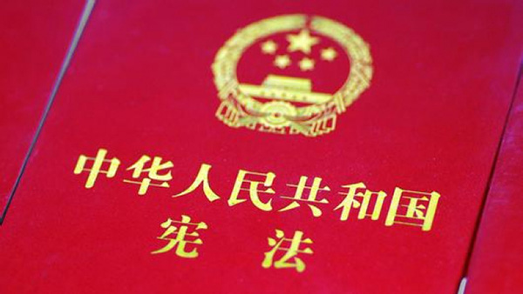
As for the official position of Chinese government (as it’s written in Constitution), it states that they’re are building socialism but it’s still at the initial stadia.
(and it’s obviously the favorable scenario)

Slide 47

Thanks for your attention! You’re welcome to ask questions…

